Slide 1


FinTech Innovation, Stability and Efficiency: Evidence from Malaysian Bank Industry
Rubi Ahmad, Changqian Xie, Fauzi Zainir and Magda Mohsin

Slide 2
1
Introduction
2
Literature Review and Hypothesis Development
CONTENTS
3
Data and Methods
4
Results and Discussion
5
Conclusion

Slide 3

1
PART
Introduction

Slide 4

Research background
02
Increasing supply
01
Increasing demand
Bank Negara Malaysia issued the digital bank licenses to five applicants on 29th April 2022 → Malaysia became the second country in ASEAN to issue digital bank licenses
The Increasing demand for online financial services during the Covid-19 pandemic (Murinde, Rizopoulos, & Zachariadis, 2022).
Challenges & Opportunities
How financial technology influences the stability and efficiency of the traditional banking sector in Malaysia?

Slide 5

Contributions
1) This study provides empirical evidence for Malaysia and similar developing countries with an open hug for FinTech development but with relatively less advanced technology infrastructure.
2) The samples in this study cover different types of banks in Malaysia, including commercial banks and Islamic banks, which provide a comprehensive view of the Malaysian banking sector.

Slide 6
Limitations
The data that can be used to purely measure the banks’ technological progress is still not available.
The uniqueness of the Malaysian banking industry limits the broad applicability of findings.

Slide 7
2
PART
Literature Review & Hypothesis Development

Slide 8
2.1 Definition of FinTech innovation
FinTech is defined as a form of financial innovation triggered by advanced technologies such as cloud computing, big data, blockchain, and artificial intelligence, which may result in new business models, applications, processes or products, and further has a material effect on the provision of financial services (CGFS & FSB, 2017).
This definition has also been adopted by the Basel Committee on Banking Supervision (BCBS).
Despite its current rapid growth (Goldstein, Jiang, & Karolyi, 2019), there is still no clear conclusion about its influence (Lee et al., 2021).
We know innovation creates not only new markets by bringing about new products and services but also replaces existing markets, which is the ‘creative destruction’ theory coined by Schumpeter (2010). This theory can also apply to the study of FinTech.
Hence, past studies on the impact of FinTech innovation on the financial industry draw two views -- the innovation-growth hypothesis and the innovation-fragility hypothesis (Beck, Chen, Lin, & Song, 2016).

Slide 9
The innovation-growth hypothesis supports that FinTech innovation improves the functions of the financial system and has a positive effect on traditional finance.
Examples : FinTech innovation fosters risk sharing (Allen & Gale, 1994) and increases economic growth (Beck et al., 2016; Laeven, Levine, & Michalopoulos, 2015).
From the perspective of the innovation-fragility hypothesis, FinTech innovation disrupts the equilibrium of the existing financial system by introducing new forms of financial risks and challenging the existing financial regulatory system (Zhang, 2020). Hence, the risk of the financial system is significantly increased.
Examples : Triggers an excessive credit expansion (Brunnermeier, 2009),increases the volatility of bank profitability (Beck et al., 2016), and affects the effectiveness of traditional monetary policy (Odularu & Okunrinboye, 2009).

Slide 10
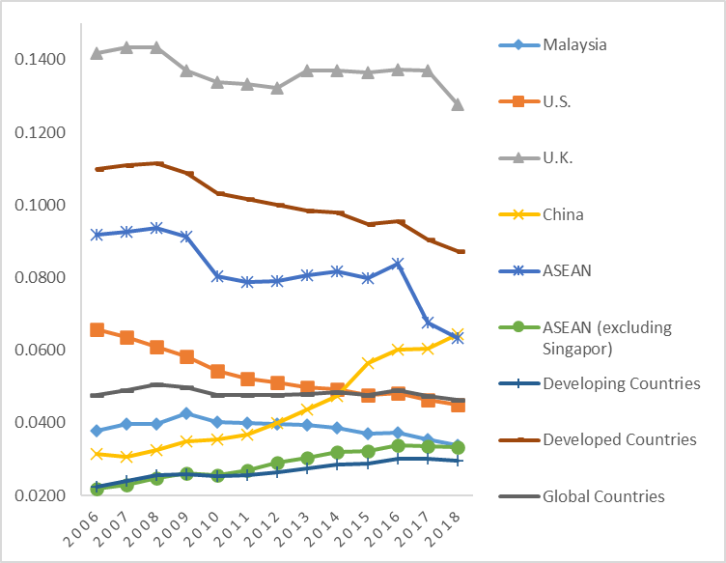
2.2 Overview of FinTech Innovation in Malaysia
We refer to the financial inclusion index provided by Meng (2020) to describe the FinTech development in Malaysia.
The index is based on the Financial Access Survey (FAS) data released by IMF in 2019
It is relatively stable, but reached a maximum value of 0.0427 in 2009
It is between the average levels of developing countries and developed countries

Slide 11
2.3 Hypothesis development
Hypothesis 1 (H1): There is a positive relationship between FinTech innovation and bank stability.
Hypothesis 1A (H1a): Compared to Islamic banks, the positive impact of FinTech innovation on banks’ stability is more significant in commercial banks.
Hypothesis 2 (H2): There is a positive relationship between FinTech innovation and bank efficiency.

Slide 12
3
PART
Data and Methods

Slide 13
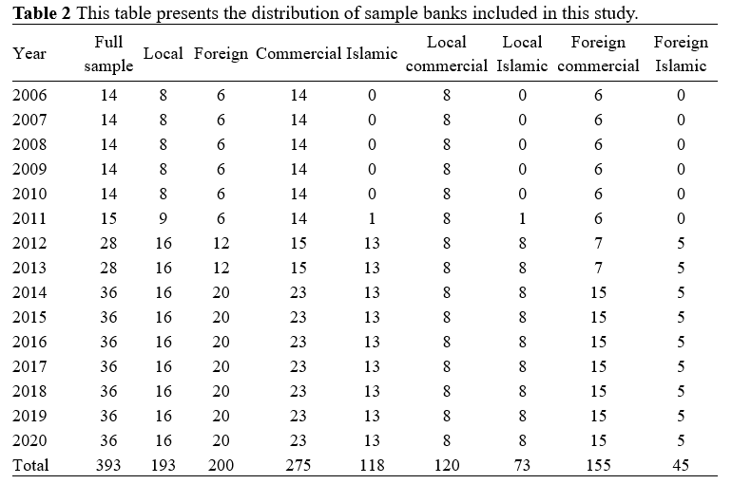
3.1 Sample selection
Oribis Bank Focus Database
Consists of 36 banks (8 local commercial banks, 8 local Islamic banks, 15 foreign commercial banks, and 5 foreign Islamic banks)
Sample period: 2006 to 2020
Final sample of 393 bank-year observations, unbalanced panel data

Slide 14

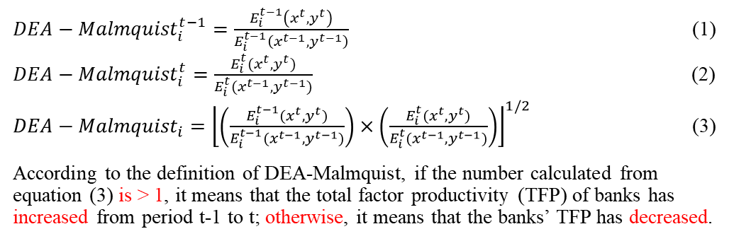
3.2 Variable description: DV
Bank stability
Z-score= $(ROA+CAR)/σ(ROA)$
The higher Z-score implies more stability
Bank efficiency
${DEA−Malmquist}_{i}^{t−1}=\frac{E_{i}^{t−1}\left(x^{t},y^{t}\right)}{E_{i}^{t−1}\left(x^{t−1},y^{t−1}\right)}$ (1)
${DEA−Malmquist}_{i}^{t}=\frac{E_{i}^{t}(x^{t},y^{t})}{E_{i}^{t}(x^{t−1},y^{t−1})}$ (2)
${DEA−Malmquist}_{i}={\left\lfloor \left(\frac{E_{i}^{t−1}(x^{t},y^{t})}{E_{i}^{t−1}(x^{t−1},y^{t−1})}\right)×\left(\frac{E_{i}^{t}(x^{t},y^{t})}{E_{i}^{t}(x^{t−1},y^{t−1})}\right)\right\rfloor }^{1/2}$ (3)
According to the definition of DEA-Malmquist, if the number calculated from equation (3) is > 1, it means that the total factor productivity (TFP) of banks has increased from period t-1 to t; otherwise, it means that the banks’ TFP has decreased.

Slide 15
Table 4: The average DEA-Malmquist score of banks in Malaysia (2006-2020).
Period | Local commercial | Local Islamic | Foreign commercial | Foreign Islamic | Full sample
2005-2006 | 0.9962 |  | 1.1302 |  | 1.0536
2006-2007 | 1.0482 |  | 1.0295 |  | 1.0402
2007-2008 | 1.0740 |  | 1.1485 |  | 1.1059
2008-2009 | 1.0141 |  | 0.8770 |  | 0.9553
2009-2010 | 1.0256 |  | 1.1420 |  | 1.0755
2010-2011 | 1.0458 |  | 0.9785 |  | 1.0170
2011-2012 | 1.0018 | 1.1770 | 1.1191 | 1.0010 | 1.0899
2012-2013 | 0.9984 | 0.9795 | 1.0001 | 1.0606 | 1.0066
2013-2014 | 1.0148 | 1.1315 | 1.3464 | 1.0399 | 1.1824
2014-2015 | 1.0372 | 1.0296 | 1.1052 | 1.0130 | 1.0605
2015-2016 | 1.0253 | 1.2159 | 1.0515 | 1.1528 | 1.0963
2016-2017 | 1.0129 | 1.1255 | 1.0008 | 1.0613 | 1.0396
2017-2018 | 1.0044 | 1.0036 | 1.2585 | 1.0223 | 1.1126
2018-2019 | 0.9958 | 0.9506 | 0.8547 | 0.9028 | 0.9140
2019-2020 | 1.0098 | 1.0108 | 1.1475 | 0.9587 | 1.0603
Average | 1.0203 | 1.0693 | 1.0793 | 1.0236 | 1.0540

Slide 16

3.2 Variable description: FinTech innovation
Challenges:
The data on R&D expenditures or patents are typically not collected or disclosed by financial institutions
Not a unified method is concluded
  - Some studies use FinTech indexes provided by professional research institutions and others use text-mining technology to collect FinTech-related keywords on the Internet to construct FinTech indexes.
FinTech2
FinTech1
Defined as total value of other intangible assets divided by total assets for each bank each year (%).
Defined as the total value of off-balance-sheet items divided by total assets for each bank each year (%) (Beck et al., 2016)
Fintech2_DUM
If the FinTech2 is missing data, equals to one, otherwise, zero. Fama and French (2015); Flannery and Rangan (2006)

Slide 17
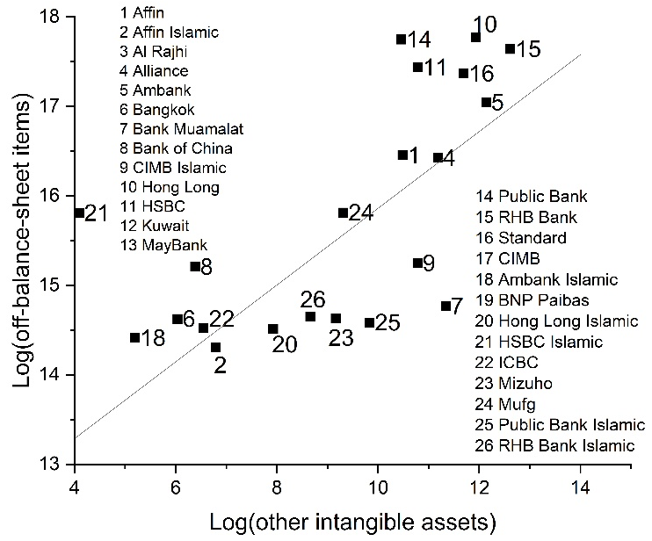
3.2 Variable description: FinTech innovation
The relationship between FinTech1 and FinTech2
a positive correlation (0.6212)

Slide 18
3.2 Definition of variables
Variable | Definition
Stability | Equals to the natural log of (ROA+CAR)/σ(ROA), the standard deviation of ROA is over the sample period for each bank. The higher Z-score implies less risk-taking and more stability.
Efficiency | Equals to the score of DEA-Malmquist.
FinTech1 | The total value of off-balance-sheet items divided by total assets for each bank each year (%).
FinTech2 | The total value of other intangible assets divided by total assets for each bank each year (%).
FinTech2_DUM | Dummy variable, if the FinTech2 is missing data, equals to one, otherwise, zero.
Size | The natural logarithm of a bank's total assets (in RM Ringgit million).
Liquidity | The value of liquid assets divided by total assets for each bank each year (%).
CapitalStructure | The value of total equity divided by total assets for each bank each year (%).
CostToIncome | Equals to the Cost to income (Efficiency) ratio (%) obtained from BankFocuse.
IncomeDiversification | Ratio of non-interest income to total operating income for each bank each year (%).

Slide 19
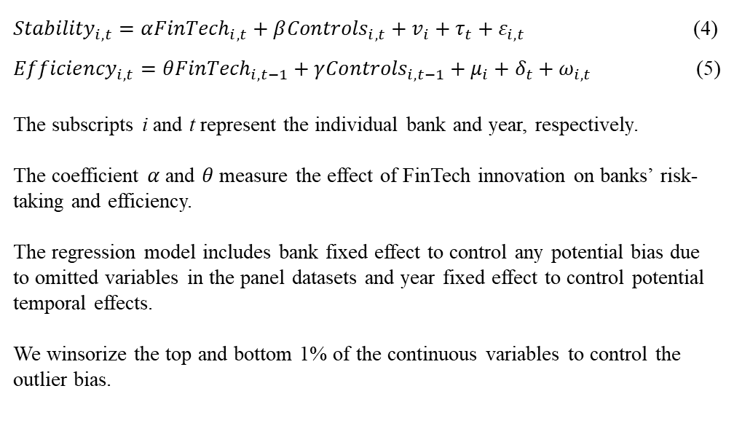
3.3 Research method
We employ the multivariate panel data regression model to test the research hypotheses.
${Stability}_{i,t}=α{FinTech}_{i, t}+β{Controls}_{i,t}+v_{i}+τ_{t}+ε_{i,t}$ (4)
${Efficiency}_{i,t}=θ{FinTech}_{i, t−1}+γ{Controls}_{i,t−1}+μ_{i}+δ_{t}+ω_{i,t}$ (5)
The subscripts i and t represent the individual bank and year, respectively.
The coefficient $α$ and $θ$ measure the effect of FinTech innovation on banks’ risk-taking and efficiency.
The regression model includes bank fixed effect to control any potential bias due to omitted variables in the panel datasets and year fixed effect to control potential temporal effects.
We winsorize the top and bottom 1% of the continuous variables to control the outlier bias.

Slide 20
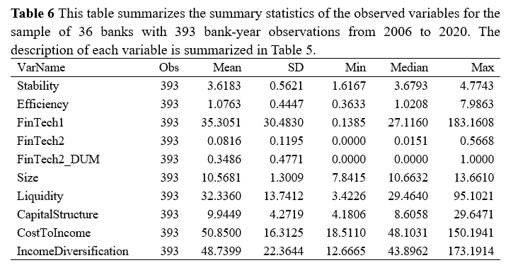
3.4 Descriptive statistics
FinTech1: mean value (35.3051%), range from minimum value (27.1160%) to maximum value (183.1608%), which suggests considerable heterogeneity in FinTech development in the years of Malaysian banks.

Slide 21
3.4 Descriptive statistics
Table 7 reports the correlation matrix of the identified variables. Overall, the correlation matrix does not suggest any serious multicollinearity concerns.
 | Stability | Efficiency | FinTech1 | FinTech2 | FinTech2_DUM | Size | Liquidity | CapitalStructure | CostToIncome | IncomeDiversification
Stability | 1
Efficiency | -0.0334 | 1
FinTech1 | -0.0579 | -0.0536 | 1
FinTech2 | -0.2128*** | -0.0766 | -0.0336 | 1
FinTech2_DUM | -0.0433 | 0.0896* | 0.0825 | -0.4998*** | 1
Size | 0.2001*** | -0.1380*** | 0.0124 | 0.1658*** | -0.2178*** | 1
Liquidity | -0.1114** | 0.1481*** | 0.0741 | -0.2264*** | 0.2725*** | -0.4845*** | 1
CapitalStructure | 0.0211 | 0.0136 | 0.0361 | -0.0466 | 0.0629 | -0.5430*** | 0.4292*** | 1
CostToIncome | -0.2698*** | -0.0003 | -0.1692*** | 0.3674*** | -0.0778 | -0.3232*** | -0.0072 | 0.1381*** | 1
IncomeDiversification | -0.0673 | 0.0206 | -0.2036*** | -0.1143** | 0.0712 | -0.2259*** | 0.0699 | -0.0890* | 0.2120*** | 1

Slide 22
4
PART
Results and Discussion

Slide 23
4.1.1 FinTech innovation and bank stability
Only in the regression of subsample (commercial banks, column 2), supporting H1a
There is obvious heterogeneity in the impact of FinTech development on bank stability.

Slide 24
4.1.2 FinTech innovation and bank efficiency
In column (1), the coefficient of FinTech1 is positive and significant at the 10% level;
In column (5) it is positive and significant at the 1% level
H2 is only significant for our full sample and foreign bank sample data leading us to conclude that full sample results are driven by foreign banks

Slide 25
4.2.1 Endogeneity concern: GMM
These results are consistent with the baseline regression results, which further confirm H1a and H2.

Slide 26
4.2.2 Replacing the dependent variable
Stability2 equals to the natural log of (ROAA+CAR)/σ(ROAA), where the standard deviation of ROAA is over the sample period for each bank, and the ROAA is the rate of return on average assets. Efficiency2 equals to the DEA-Malmquist score calculated by three input variables (labour, fixed assets, and total deposits) and three out variables (total loans, other earning assets, and non-interest income), referring to Lee et al. (2021).

Slide 27
4.2.4 Additional analysis: size effect
Overall, the impact of FinTech innovation on banks’ stability and efficiency varies by bank size.
Big-sized banks are defined as those with total assets exceeding the median value of 36 banks’ total assets. Small-sized banks are those less than the median value.

Slide 28
4.2.4 Additional analysis: profitability effect
Columns (1) show that banks with high ROE have significantly improved their stability with higher development of FinTech.
However, banks with low ROE enjoy a significant effect of improving efficiency brought by FinTech, as shown in column (4)
Banks in the high ROE group are defined as those whose ROE exceeds the median ROE of the sample banks, and those in the low ROE group are on the contrary.

Slide 29
5
PART
Conclusion

Slide 30
Conclusion
1
Compared with Islamic banks, FinTech innovation significantly improves the stability of commercial banks
2
FinTech innovation has a more significant effect on improving foreign banks’ efficiency than local banks
3
These baseline results are affirmed using the GMM approach to mitigate potential endogeneity issues
4
Heterogeneity analysis: the high-profit banks enjoy the benefits of improving their stability level from FinTech development. However, for the small-sized and low-profit banks, FinTech innovation contributes more to improving their efficiency.

Slide 31
Implications
The impact of Financial innovation on Malaysian traditional banks is therefore heterogeneous. For example, the big-sized and high-profit banks enjoy the benefits of improving their stability level from FinTech development while the small-sized and low-profit banks, more to improving their efficiency.
When looking at the growth of financial innovation and its impact on bank stability and efficiency, it is essential to investigate this relationship thoroughly from different standpoints and under various conditions.
A need for financial regulatory authorities to update their financial supervision methods in real-time, as the wide usage of FinTech increases the business complexity of banks.

Slide 32
Main reference
Thakor, A. V. (2020). Fintech and banking: What do we know?. Journal of Financial Intermediation, 41, 100833.
Beck, T., Chen, T., Lin, C., & Song, F. M. (2016). Financial innovation: The bright and the dark sides. Journal of Banking & Finance, 72, 28-51.
Murinde, V., Rizopoulos, E., & Zachariadis, M. (2022). The impact of the FinTech revolution on the future of banking Opportunities and risks. International Review of Financial Analysis, 102103.
Lee, C. C., Li, X., Yu, C. H., & Zhao, J. (2021). Does fintech innovation improve bank efficiency? Evidence from China’s banking industry. International Review of Economics & Finance, 74, 468-483.
Hu, D., Zhao, S., & Yang, F. (2022). Will fintech development increase commercial banks risk-taking? Evidence from China. Electronic Commerce Research, 1-31.
Ahamed, M. M., & Mallick, S. K. (2019). Is financial inclusion good for bank stability? International evidence. Journal of Economic Behavior & Organization, 157, 403-427.
Wang, R., Liu, J., & Luo, H. (2021). Fintech development and bank risk taking in China. The European Journal of Finance, 27(4-5), 397-418.

Slide 33
THANKS

